Slide 1
Engineering Management
Introduction to Engineering Management
Lecture 123

Slide 2
MANAGEMENT
Management is the attainment of organizational goals in an effective and efficient manner through planning, organizing, staffing, directing and controlling organizational resources.
Organizational resources include men(human beings), money, machines and materials.

Slide 3
Definitions
Louis E Boone & David L Kurtz- The use of people and other resources to accomplish objectives.
Mary Parker Follet- the act of getting things done through people.
Frederick Taylor defines Management as the art of knowing what you want to do in the best and cheapest way.

Slide 4
Engineering Management
Engineering management is the fusion of business and engineering principles.
By having knowledge of economics and management they can forecast or can predict the utility, advantages, disadvantages of the product. also get to know the scope of the product and it's contribution in growth.
Specialized form of management that is concerned with the application of engineering principles to business practice.
Career that brings together the technological problem-solving savvy of engineering and the organizational, administrative, and planning abilities of management in order to oversee complex enterprises from conception to completion.

Slide 5
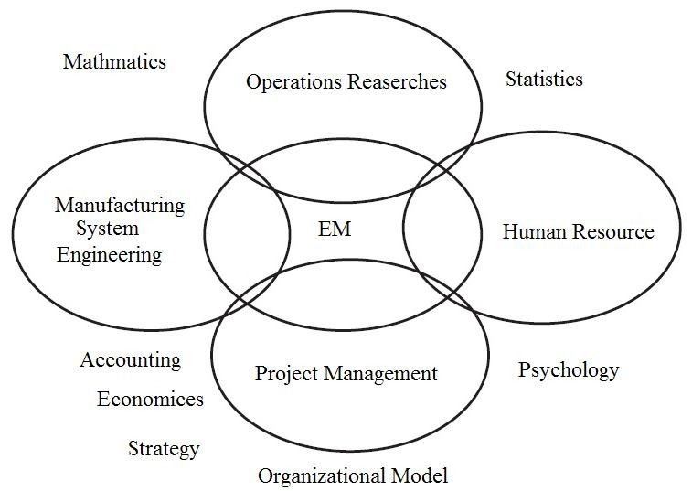
Engineering Management Domain

Slide 6
Engineering Management
Example areas of engineering management area are:
Product development
Manufacturing
Construction
Design engineering
Industrial engineering
Technology
Production
Successful engineering managers typically require training and experience in business and engineering to:
Operating effectiveness and efficiency is
Problem solving and operations improvement
Managers within the field of engineering are trained to understand Human resource management, finances, industrial psychology, quality control, operations research and environmental management.

Slide 7


Engineering Management
Engineering | Management
The profession in which a knowledge of | A set of activities (including planning and
the mathematical and natural science | decision making, organising, leading and
gained by study, experience, and practice | control) directed at an organisation’s
is applied with judgement to develop ways to utilize, | resources (human, financial, physical and informational) with
economically, the | the aim of achieving
materials and | organisational goals
forces of nature | in an efficient and
for the benefit of | effective manner.
mankind

Slide 8
Management Philosophies
The different management philosophies have been numerous. All have had, as their goal, to obtain optimal organizational performance, with the overall business environment guiding the selection of a particular style of management.
Some theories have been fads that have not influenced a company’s performance in the long term, while others have enhanced quality and productivity.
Each theory has had its merits and drawbacks. These philosophies may be grouped into general categories of
Scientific
Administrative
Behavioral

Slide 9
1. Scientific Management
Charles Babbage (1792-1871)
Invented 1st mechanical calculator “difference engine”
Method of observing manufacturers (1832)
Henry Towne and ASME: Management Div. (1886)
Frederic W. Taylor: (1856-1915)
Time and Motion Studies
Believed in selecting, training, teaching, and developing workers

Slide 10
1. Scientific Management
Frank B. Gilbreth: (1868-1924)
Best way of laying bricks
Devised a system for classifying hand motions into 17 basic divisions
• Lillian Moller Gilbreth: (1878-1972)
Psychology of Management (Human Factors)
First Lady of Management

Slide 11
1. Scientific Management
Replaced old rule of thumb
Believed in selecting, training, teaching and developing workers
Time Study
Standards planning

Slide 12
1. Criticism of Scientific Management
Productivity, not quality
• Separating planning and execution

Slide 13
2. Administrative Management
• Henri Fayol (1841-1925):
Developed 14 “general principles of administration”
Divided management activities into five divisions (Planning, Organizing, Command, Coordination, Control)
• Max Weber (1864-1920):
Division of labor
Hierarchy of authority
Employment-based on expertise
Decisions & rules in writing
Separation of management & ownership

Slide 14
3. Behavioral Management
• Hawthorne Studies
Original intent was to find the level of illumination that made the work of female coil winders, relay assemblers, and small parts inspectors more efficient.
Conclusion - persons singled out for special attention perform as expected
• Abilene Paradox
Failing to manage agreement effectively

Slide 15
3. Behavioral Management
• Maslow:
Hierarchical theory of human needs
Biological / Physiological Needs
Security / Safety Needs
Social Needs
Ego Needs
Self-actualization Fulfillment

